Slide 1
NB of Ukraine-NB of Poland 2023, Annual Research Conference
June 23, Krakow
Croatian Experience and Lessons of Economic and Financial Development During and After the War
Boris Vujcic
Governor
Croatian National Bank

Slide 2
Overview
The Croatian War of Independence
The Impact of War on Economic Growth
Structural Reforms in the Banking Sector after the War
Stopping High Inflation and Reforming Monetary Policy Framework During and in the Aftermath of the War

Slide 3
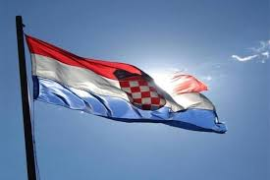
The Croatian War of Independence
Separation from The Socialist Federal Republic of Yugoslavia
  April and May, 1990 - The first multi-party democratic elections
  December 22, 1990 – The Croatian Parliament adopted the Constitution of the Republic of Croatia („The Christmas constitution”)
  June 25, 1991 - Independence from the SFRY

Slide 4
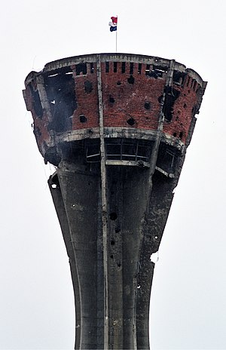
The Croatian War of Independence
War lasted from 1991 to 1995
  1991: The first armed conflct was the Pakrac clash (March 1), followed by „The Plitvice Bloody Easter” (March 31)
  1995: The last major combat operation was Operation Storm (August 5-8,1995).
  Formally, the war ended by signing the Erdut Agreement (November 15, 1995).
August 5th: Victory and Homeland Thanksgiving Day and the Day of Croatian Defenders
Notes:
According to the data of the State Audit for the Inventory and Assessment of War Damage, direct war damage in Croatia in the period 1990-1999. was 236,431,568,000 HRK (which is 31,1 bilion euros)

Slide 5
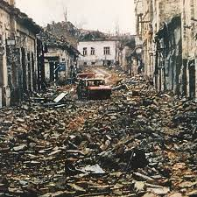
The Croatian War of Independence
There were about 16 thousand killed (of whom 43.4% were civilians), and about 35 thousand wounded people on the Croatian side.
  Out of 4,4 million population – 0.4% died, 0.8% were wounded.
14,760 km2 (26%) of the Croatian territory was under occupation.
More than half (54%) of total territory inhabited by 36% of total population suffered war damages.
Up to 300,000 Croats were displaced, while total number of displaced persons including refugees from B&H peaked at about half a million.
15% of housing units and 2,423 cultural heritage structures, including 495 sacral structures, were destroyed or damaged.
Total war damages were estimated (in 1999) at around 31 billion euro (around 150% of Croatia’s 1990 GDP).
Notes:
More than thousand of 16 thousand are still considered missing.
According to the data of the State Audit for the Inventory and Assessment of War Damage, direct war damage in Croatia in the period 1990-1999. was 236,431,568,000 HRK (which is 31,1 bilion euro) (Izvor: Ministarstvo rada i socijalne skrbi, Marijan Perković, Vlado Puljiz)

Slide 6
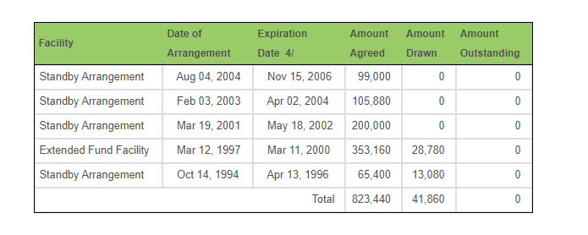
Croatia had five arrangements with the IMF, but used very little money, overall, up until the EU entry, inflow of official funds was modest
IMF – Lending comitments, in thousands of SDRs
Source: IMF

Slide 7
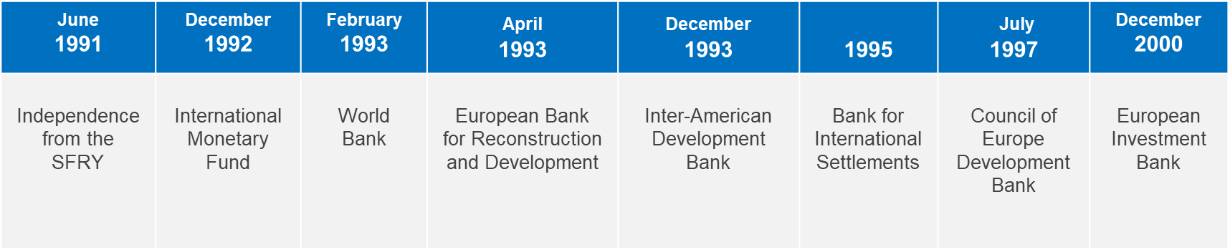
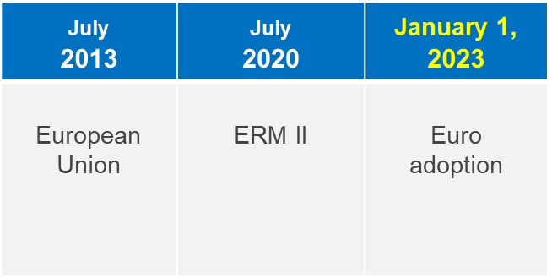
Croatia’s international integration since independence

Slide 8
The Impact of the War on Economic Growth
While war results in destruction of lives and property, economic growth tends to strongly recover in the aftermath of the war
According to the neoclassical theory, the positive effect of war on economic growth can be achieved through different channels:
Investment growth: „phoenix factor„ (Organski& Kugler,1977)
Technological progress
Increase in the savings rate
Notes:
Investment growth ("phoenix factor")
Germany, Italy and Japan, which after a significant loss of capital during the Second World War, in the post-war period recorded extremely high growth rates of investment activity and strong economic growth
Technological progress
During the Second World War, many new technological innovations were discovered such as improvements in the use of energy, radar, new communication devices, etc., which were later reflected in the improvement of overall welfare and greater growth in production.
Increase in the savings rate
A change in the saving rate has a level effect but not a growth effect in Sollow model (i.e. a permanent increase in the saving rate produces a temporary increase in the growth rate). During The Second World War in the United States of America household accumulated savings and increased their propensity to save. In the upcoming period higher propensity to save had a positive temporary effect on economic growth.

Slide 9
... reasons for positive relationship between war and economic growth after the war
The war can destroy networks of old political and economic interest groups that limited growth by protecting their partial interests at the expense of the public one (Olson, 1982).
Positive impact of war on human capital because better management and organizational skills are acquired (Dulles, 1942).
Removal of trade restrictions and increase of international cooperation after the war (as for example after the World War II).

Slide 10
"Phoenix factor" – case of Germany, Japan and Croatia
Note: The data refer to GDP per capita, 2011 prices. „War years” for Germany refers to period from 1941 to 1946, for Japan from 1942 to 1946, and for Croatia from 1990 to 1993.
Source: Maddison Project Database (MPD) 2020, CNB calculation
Notes:
"Phoenix factor" existed in Croatia, albeit the effect was of a smaller magnitude than in the post-war reconstruction of countries after the Second World War. Compared to Germany and Japan after World War II, Croatia had smaller cumulative decline in GDP per capita and lower average post-war reconstruction growth rate. The cumulative drop in real GDP per capita in the war years (1990-1993) amounted 32,5%. The recovery of GDP per capita started before the end of the war, in 1994, and with an average rate of 6,1%, it reached the pre-war level (1989) yet in 2002. Therefore, Croatia's economic recovery from the war lasted for 9 years.

Slide 11
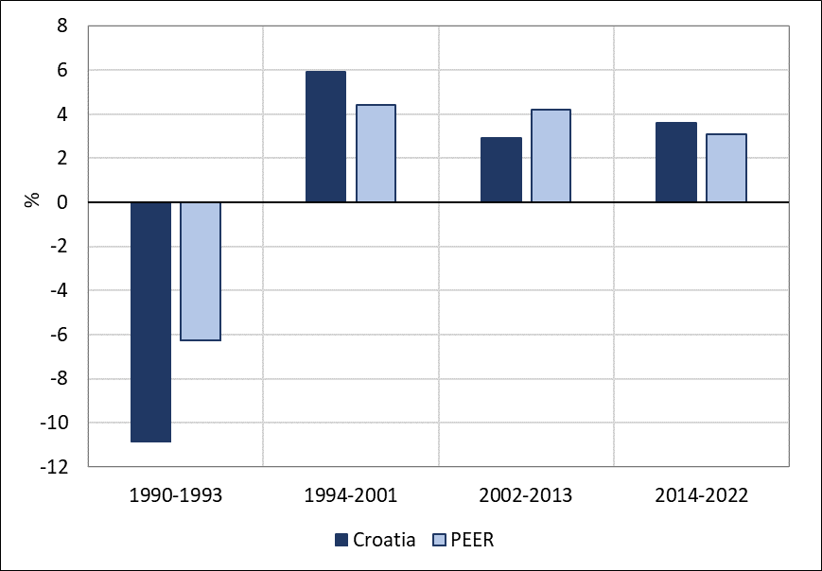
Economic growth slowed-down substantially after the disappearance of the "phoenix factor"
Average growth rates of GDP per capita
Note: PEER countries refer to Bulgaria, Czech Republic, Estonia, Hungary, Lithuania, Latvia, Poland, Romania, Slovakia and Slovenia.
Source: Maddison Project Database (MPD) 2020, Ameco, CNB calculation.
Notes:
After the gradual disappearance of the "phoenix factor", the Croatian economy began divergent movements in relation to the CEE countries; the average growth rate was slowing down significantly, while it was accelerating in other countries.

Slide 12
Main reasons for a relative slowdown in 2002-2013 period
No EU integration, significant disadvantage to the Peer group of countries - diversion of trade and investments
Low labour force participation compared to the peers (large share of disability pensions and war veterans, most of whom were working age population but retired)
25 p.p higher public debt compared to the peer group of countries, mainly as a result of war
State owned companies and general government too large and inefficient
Lack of significant structural reforms (product and labor market reforms)
Notes:
1) Croatia joined the EU in 2013 that was nine years after comparable countries depicted in above figures. The EU accession was a game changer of exports performance.
2) Relatively higher share of expenditures and public debt in GDP than in peer countries (for example, public debt is about 25 percentage points above the peer countries average). Worse ranking in various product market and business climate indicators point to its low efficiency.
3) To a large extent due to generous retirement conditions for war veterans. Therefore, most of them are part of the working age population but retired. In addition to it, emigration abroad shrank the labour force and reduced its skills.

Slide 13
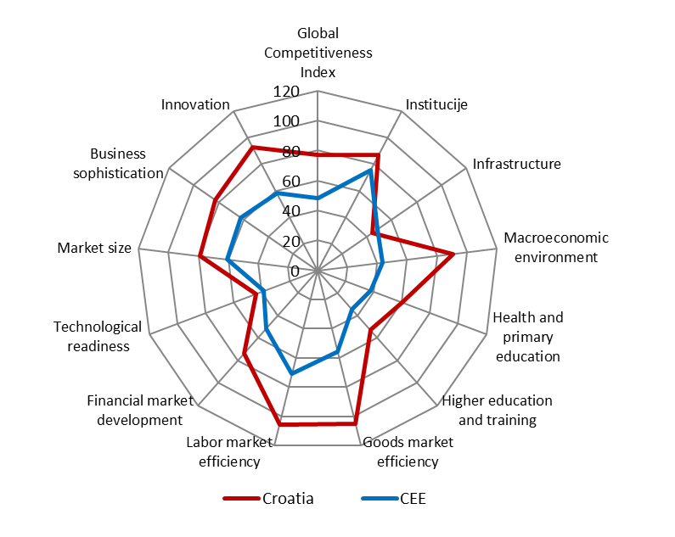
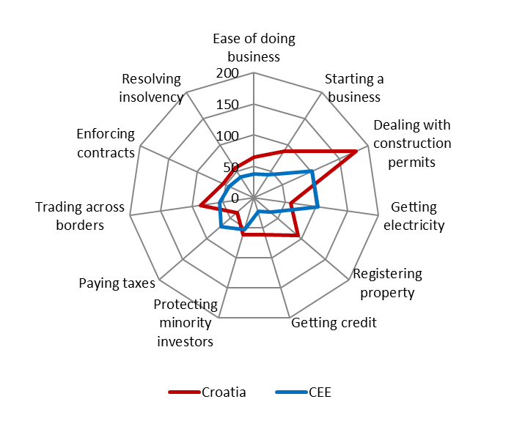
... resulting in a relatively poor business environment
Doing Business
Global Competitiveness Index
Note: Ranking – higher score means worse position. PEER countries refer to Bulgaria, Czech Republic, Estonia, Hungary, Lithuania, Latvia, Poland, Romania, Slovakia and Slovenia.
Source: World Bank, Doing Business 2015
Note: Ranking – higher score means worse position.
Source: World Economic Forum, Global Competitiveness Report 2014-2015

Slide 14
Structural Reforms in the Banking Sector after the War
  Legacy issues in the banking sector dating back to socialist Yugoslavia
  Why structural reforms in the banking sector are needed after the war?
  Bank rehabilitation in 1991/1992
  Subsequent rehabilitations and privatization of banks

Slide 15
1) Legacy issues in the banking sector dating back to socialist Yugoslavia
Before the war, the banking system was exposed to serious operational difficulties, with a large number of insolvent banks.
Croatian National Bank noted the following in its 1991 Annual Report:
“At the end of 1990 ... five banks were solvent, ten banks were solvent with problems related to the settlement of claims, eleven banks were technically insolvent and two banks were seriously technically insolvent.”
Accordingly, prior to the war, 13 out of a total of 28 banks were insolvent.
Therefore, in 1990s the Croatian National Bank was trying to forge a political consensus for rehabilitation and restructuring of banks.

Slide 16
2) Why structural reforms in the banking sector were needed after the war?
Many bank clients are negatively affected by the war, some clients may cease to exist or temporarily go out of business. In such a context it is likely that some claims can never be recovered, or that they can be recovered only after a long period of time.
Large share of such problem assets tend to increase lending interest rates that also hit clients not directly affected by the war. Structural reforms should aim to limit spillovers from bad to good assets.

Slide 17
3) In 1991 and 1992 government issued bonds for rehabilitation of banks
"Big bonds" indexed to producer prices
  Recapitalization of failed state owned enterprises, which used bonds to repay debts
  Issued in November 1991 in amount of 1 billion USD (6% of 1991 GDP), for a period of 20 years, they were almost 15% of the banks' total exposure to companies
Bonds in foreign currency
  Turning household FX deposits into public debt in December 1991
  3 billion USD (19% of 1991 GDP) repaid in 20 half-yearly instalments, starting in 1995, with 5% interest
Above bonds replaced about 50 per cent of total bank assets and improved the quality of banks assets:
  Positive impact of big bonds on banks' asset quality and capital adequacy was much higher than expected. Bonds were indexed to inflation, while the value of other assets and liabilities in domestic currency declined rapidly in real terms because of high and rising inflation.
  Bonds in foreign currency replaced claims in foreign currency on the National Bank of Yugoslavia (NBY) in banks' balance sheet that became worthless after the breakup of Yugoslavia.
Bonds solved solvency but not liquidity problems of banks.
Notes:
Government granted big bonds mainly to agricultural conglomerates, shipbuilding enterprises and enterprises oriented to the former Soviet Union and Eastern Europe market, who thereby paid their obligations to banks. This involved large government-owned enterprises, i.e. clients of large banks.
When bonds in foreign currency were issued, deposits in foreign currency were blocked and repaid for 10 years. To be more precise, in the SFRY, the Croatian citizens mostly saved in foreign currencies, which banks were obligated to deposit with the NBY.
When bonds were issued, there was no market for government bonds and government borrowing was only in the form of book credit. Banks with huge share of rehabilitation bonds in their total assets faced a scarcity of collateral for borrowing from the central bank. To ensure equal playing field for banks and monetary policy transmission mechanism to work, central bank could consider accepting rehabilitation bonds as the collateral for bank borrowing from the central bank.

Slide 18
4) Subsequent rehabilitation and privatization of banks
Bank rehabilitation operations assured bank solvency and minimum capital, but their negative by-product was:
  state-owned banks mostly continued accumulating losses, largely due to further cumulation of non-performing placements to big state-owned enterprises with operational problems;
  significant changes did not occur in banks’ business models. Banks that previously cumulated losses continued to operate poorly.
In 1996, three out of four biggest banks were again in the need of rehabilitation. Largest one was not because it was mostly retail bank.

Slide 19
4) Subsequent rehabilitations and privatization of banks (continued)
Rehabilitation oh three large state own banks was on case-by-case basis and involved:
  1) Bank equity has been written-down
  2) Banks were downsized and recapitalized by government
  3) Bank management was replaced
After rehabilitation interest rates declined strongly.
But, two sets of bank rehabilitation,during and after the war have increased public debt above the level in peer group of transition economies
Notes:
Bad claims were removed from the balance sheet and transferred to a special government agency. Claims fell due as originally negotiated, but the agency had opportunity to restructure or even forgive transferred debt in the context of direct rehabilitation of the enterprises. Government issued new bonds for bank rehabilitation as much as was needed to meet bank capital adequacy requirement.
Government appointed new management in collaboration with the CNB. In the short run main task of new management was to prevent granting further credit to bad debtors and reduce operating expenses. In the long run it was to develop new more efficient business model.
Government sold banks to major regional banks. This was considered a major step towards better banking business in the long run.

Slide 20
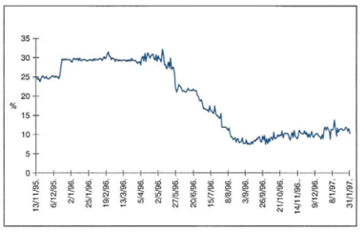
4) Subsequent rehabilitation and privatization of banks (continued)
Overnight interest rate on the intrabank market
Interest rates for short-term borrowing on the money market fell from 26.3 percent in the second quarter to 11.4 percent in the third quarter of 1996.
After this one-time adjustment, a general decline continued and in the fourth quarter of 1997 reached the level of 8.9 percent.
Source: Croatian National Bank

Slide 21
Stopping High Inflation and Reforming Monetary Policy Framework During and After the War
  Macroeconomic context at the beginning of 1990s
  Anti-inflationary/stabilization program during the war, in October 1993
  Monetary policy in the aftermath of the war
  Macroprudential measures and boom bust cycle in 2000s

Slide 22
1) Macroeconomic context at the beginning of 1990s
Temporary currency issued by the government was in circulation from 1992 to 1994
Very high and increasing inflation, currency was not convertible
No international reserves and foreign debt in default
Huge capital outflows prior to the war, followed by secular inflows after the independence
Croatia was not a member of international financial institutions – no external help
Notes:
The CNB proposed to government to issue temporary currency because there were no tools to ensure currency stability. It could have got very low reputation as the NBY did.

Slide 23
1) Macroeconomic context at the beginning of 1990s (continued)
Central bank policy:
  Without international reserves only available option for the exchange rate regime was the full flexibility of the exchange rate.
  The central bank reform priority was to develop foreign exchange market in Croatia.
  High inflation was coupled with strong nominal deprecation.
Notes:
Banks were authorised to buy and sell foreign currency, and were required to report to the central bank on their foreign currency trading and positions. Foreign exchange market was not operating smoothly but was developing gradually.
Exchange rate appreciated in real terms due to capital inflows. At the beginning they were mostly coming from mattresses and Croats living abroad, and from foreigner borrowings after foreign debt was regularized in 1995 and 1996

Slide 24
2) Anti-inflationary program in October 1993
Inflation was mostly caused by deeply rooted inflationary expectations that were fueled by fast nominal exchange rate depreciation.
The key element of the program was to break the depreciation expectations.
Ceiling for the HRK/DEM exchange rate was announced in October 1993 following an initial one-off devaluation (23%).
After the announcement, the exchange rate started to appreciate strongly and by the end of November 1994 it had returned to the level where it was immediately before the announcement of the program i.e. before the one-off devaluation.
The strong appreciation of the exchange rate quickly curbed inflationary expectations and inflation.
The credibility of the program was further reinforced by full external convertibility of currency that was proclaimed at the end of May 1995.
Notes:
Inflation was not caused by excess demand or other usual pressures to the rise in prices, but that it was instead the result of deeply rooted inflationary expectations that we were fuelled by fast nominal exchange rate depreciation.
The key element of the Stabilisation Programme launched in October 1993. was the initial one-off devaluation (23%) and the announcement that the new exchange rate of the Croatian dinar relative to the German mark is at upper exchange rate band. The central bank never formalized upper exchange rate band.
As the newly announced exchange rate was in disarray with the market exchange rate before the launch of the program itself, the exchange rate started to appreciate strongly on the first day of program announcement, and by the end of November 1994 it had returned to the level immediately before the announcement of the program. It never reached again the announced upper band.
The strong appreciation of the exchange rate quickly curbed inflationary expectations and inflation. The credibility of the programme was further reinforced by full external convertibility of currency that was proclaimed at the end of May 1995.

Slide 25
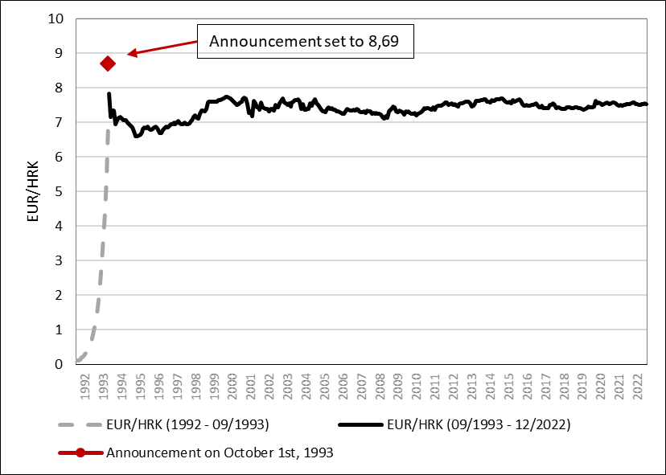
2) Anti-inflationary program in October 1993 (continued)
Exchange rate eur/hrk
Source: Croatian National Bank

Slide 26
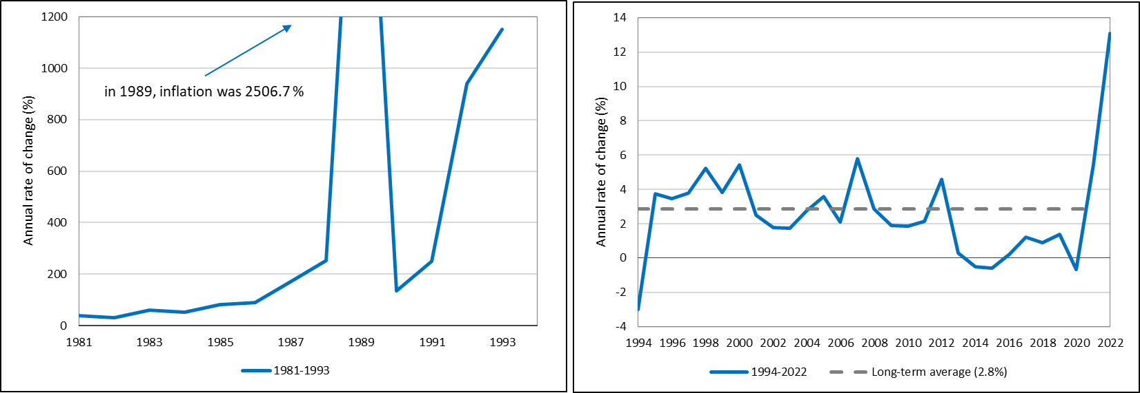
Successful stabilization program in 1993 after couple of bouts of hyperinflation before and during the war/start of the transition
Consumer price index (1981-1993)
Consumer price index (1994-2022)
Note: Data refer to end-of-period data for December.
Source: Croatian National Bank
Note: Data refer to end-of-period data for December. Long-term average refers to period from 1996 to 2022.
Source: Croatian National Bank

Slide 27
3) Monetary policy in the aftermath of the war
High euroization and memory of huge exchange rate depreciation required strong containment of FX volatility, but exchange rate was never fixed in order not to provide one-way bet for the markets.
Monetary policy was based on the exchange rate anchor, and managed floating of exchange rate replaced free floating that existed at the beginning of 1990s.
The central bank also had to build international reserves.
  Currency was exposed to appreciation pressures due to capital inflows, so this was easy to do.
  International reserves for most of the subsequent period exceeded 99% of central bank assets.
The exchange rate channel was used to control inflation.
  While central bank contained short-term exchange rate fluctuations by intervening in the foreign exchange market, exchange rate would gradually adjust over the longer horizon.
  In case of large capital inflows and overheating, the central bank would allow for a moderate appreciation.

Slide 28
4) Macroprudential measures and boom bust cycle in 2000s
In 2000s, Croatia experienced lending boom on the back of gradual financial integration. In search for a profit and market share banks turned to foreign (mother) sources of financing, amid extremely favourable financing conditions and high liquidity at the global level.
Clear signs of overheating of the economy were the rapid credit growth, an unsustainable current account deficit (close to 10 percent of GDP), a leap in the external debt and indications of price bubbles in the real estate and securities markets.
In the period of large capital inflows, raising central bank interest rates to tame the business cycle was not the policy option due to the risk of exacerbating capital inflows event further.
Therefore, in the period from 2003 to 2007, the CNB implemented a range of measures to limit excessive lending – mainly additional liquidity and capital requirements. Later, these measures were labeled - the macroprudential policy toolkit.

Slide 29
Macro-prudential measures were introduced early and expanded gradually ...
Source: CNB.

Slide 30
... while instruments were progressively tightened.
Source: CNB.
Notes:
30

Slide 31
Problem without the solution until the euro adoption
  High informal euroization in Croatia (eventually resolved by euro adoption)
Indebtedness of domestic sectors in Croatia, currency structure, Dec 2022
Share of FX loans and deposits in Ukraine
Source: CNB.
Source: Ukranian National Bank
Notes:
Euroization inherited from former SFRY did not decline but even increased. In 1990s there was high asset euroization arising from high share of foreign currency government bonds in total assets, and large deposit euroization arising from high share foreign currency households' deposits in total deposits. In 2000s assets and liabilities' structure was different but even more euroized: on the assets side most of placements to domestic sectors was indexed to foreign currency, and on the liability side most of domestic sectors' deposits was opened in foreign currency. Such structure of bank assets meant that bank borrowers were highly exposed to the exchange rate risk, and banks were highly exposed to credit risk (i.e. to currency induced risk). These risks were eventually eliminated by the adoption of euro.
After privatization of large banks households became the most important banks' client among institutions sectors, and this is still today although their share is declining. Such structure of bank lending, in particular when it is financed by foreign borrowing has negative impact on growth in a long run. Share of lending to nonfinancial enterprises in total assets has been declining steadily. It declined form about 40% percent after privatization of large banks to about 19% at the end of 2022. On the other hand, share of lending to households in total increased from 15% to 34% prior to the Great financial crisis, and afterwards it declined. At the end of 2022 it was at 26%.

Slide 32
Some lessons from the war and aftermath of the war
War – even a very destructive one - does not bring permanent ruin
  „Phoenix miracles” are even somewhat of a norm as multitude of factors pushes-up growth
However, structural reforms are needed in order to maximize the rebound and make it sustainable
  likely problems after the war
    destroyed assets, spill-over to good assets thru the banking system exposures
    elevated public debt
    low labour force participation rate (emmigration, brain drain, war veterans...)
    macroeconomic instability, inflation, exchange rate
    currency substitution?
    business climate

Slide 33
Some lessons from the war and aftermath of the war
Central bank should focus on two areas – price stability and financial stability
  Prices can be stabilized even during the war, which further supports growth
  Wars kill many people and damage physical property – but they also hurt balance sheets of banks – these need to be repaired as soon as possible when the shooting stops
When the reconstruction starts, keep an eye on capital inflows and stay vigilant on macro-prudential front in order to manage the boom-bust cycle
Monetary policy in the aftermath of the war may not fully regain manoeuvring space, particularly if dollarization (euroization) is high (even before the war)

Slide 34
THANK YOU.

